Slide 1

Adding a timeline to your web app
Joe Wilson, Owner
Volare Systems, Inc.
@joe_in_denver
joe@volaresystems.com
303-532-5838

Slide 2

@joe_in_denver
joe@volaresystems.com
303-532-5838

Slide 3
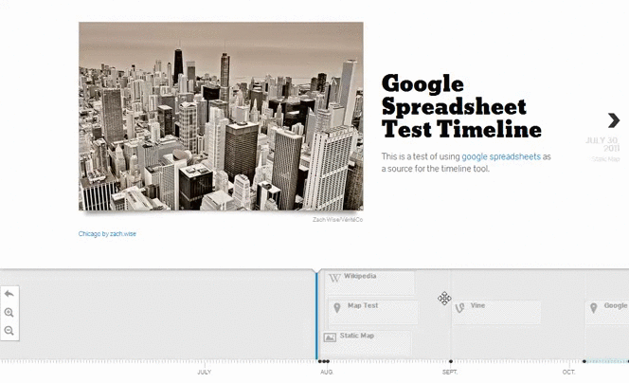

@joe_in_denver
joe@volaresystems.com
303-532-5838

Slide 4
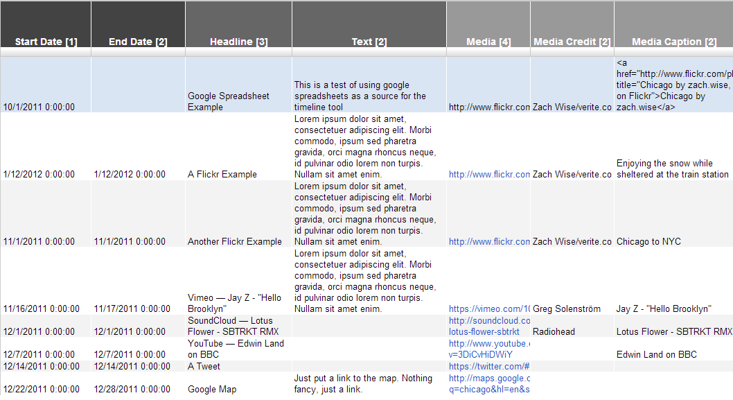
Add data to Google Spreadsheet template
@joe_in_denver
joe@volaresystems.com
303-532-5838

Slide 5
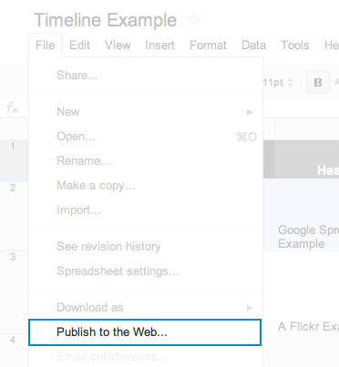
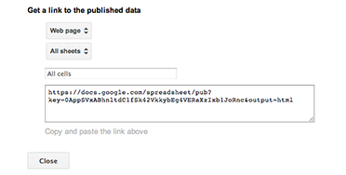
Publish and link spreadsheet
@joe_in_denver
joe@volaresystems.com
303-532-5838

Slide 6
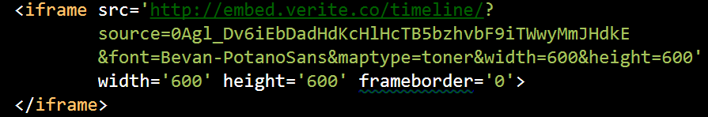
Paste the iframe
@joe_in_denver
joe@volaresystems.com
303-532-5838

Slide 7

@joe_in_denver
joe@volaresystems.com
303-532-5838

Slide 8
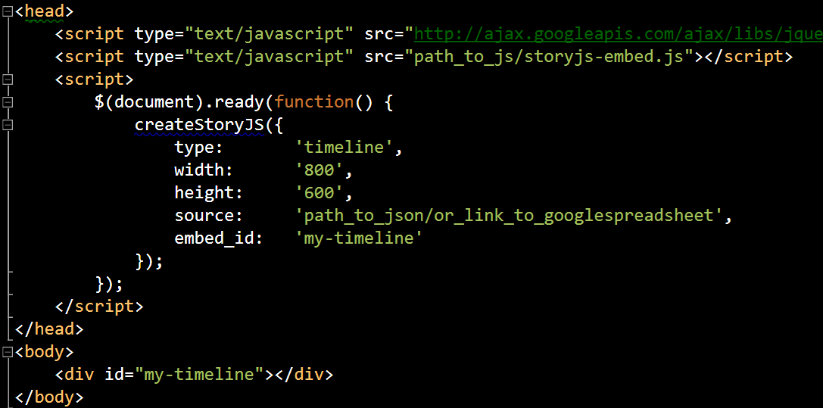
Or, code it with JavaScript
@joe_in_denver
joe@volaresystems.com
303-532-5838

Slide 9
Other details…
Works with modern browsers and IE8+
More than 20-30 items in your timeline will slow it down
Licensing is Mozilla Public License, v2.0
Open source with source code on GitHub
@joe_in_denver
joe@volaresystems.com
303-532-5838

Slide 10
More info…
http://VolareSystems.com/blog
@joe_in_denver
joe@volaresystems.com
303-532-5838

